Slide 1
NHS Leeds CCG budget
Third sector 18/19 spend and financial planning for 2020/21

Slide 2
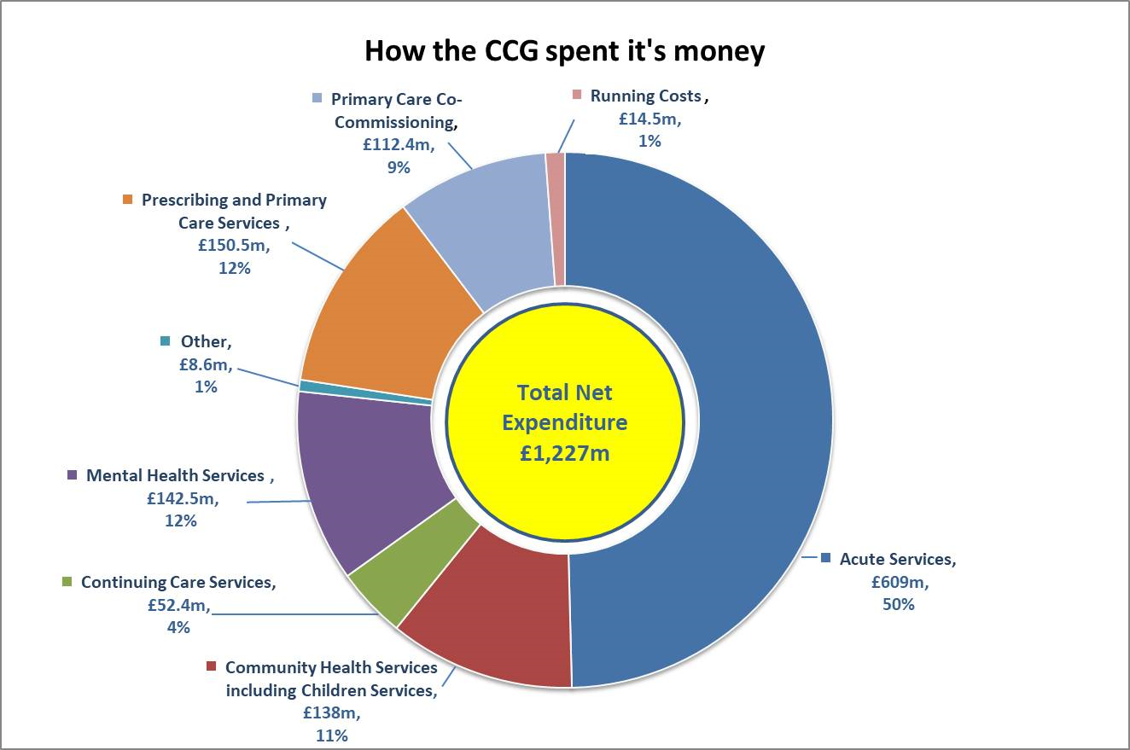
CCG commissioning budget 18/19
Notes:
The CCG is responsible for the strategic planning, procurement (contracting), monitoring and evaluation of the performance of a prescribed set of services that are delivered by a range of NHS, independent and third sector health and care providers in order to meet the needs of our local population. These services provide a range of hospital treatments, rehabilitation services, urgent and emergency care, community health services, mental health and learning disability services. Each year the CCG undertakes a planning process that provides the key mechanism for ensuring our plans are meeting our population’s needs and will continue to do so within available resources.

Slide 3
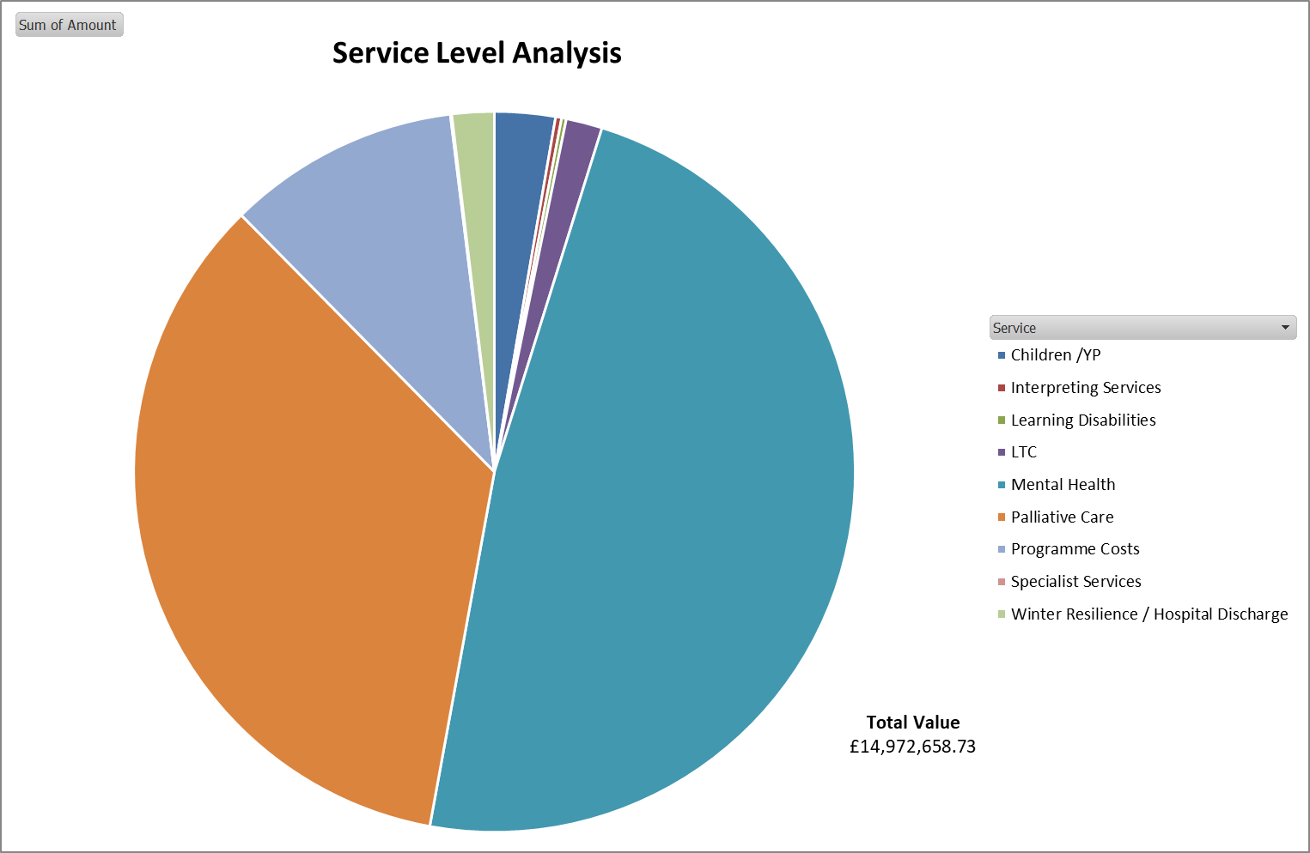
Service level analysis
Notes:
Analysis doesn’t include investment transferred to LCC (i.e Carers support, LD, children services, older people) – this would more than double investment

Slide 4
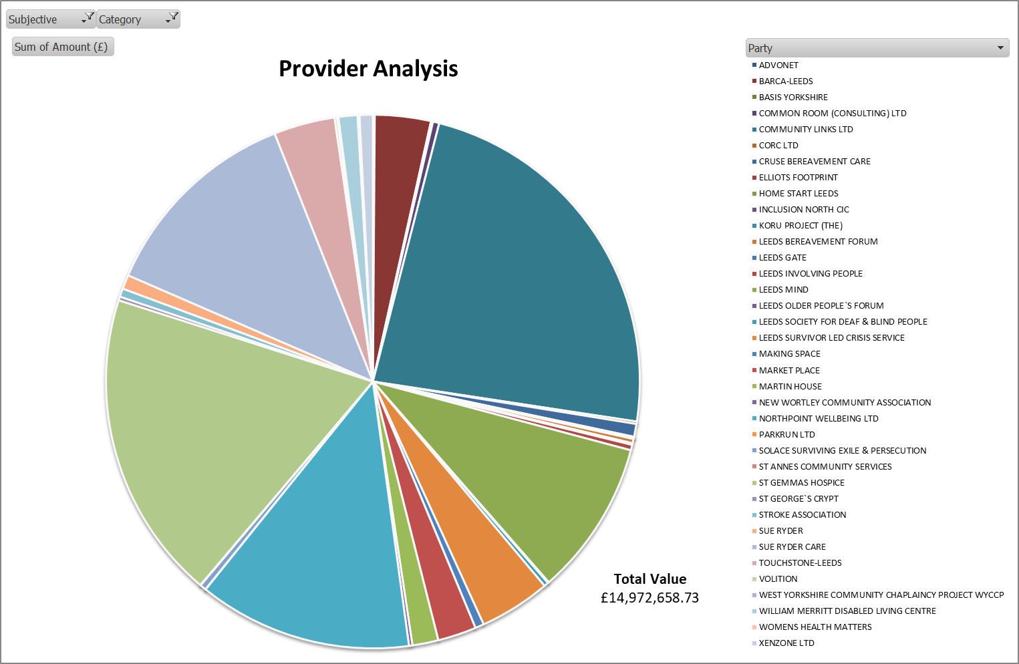
Provider analysis

Slide 5
Proposed 20/21 investments
Proposed planning and investment
Strategic thinking to increased budget reflecting pre-commitments, parity of esteem or left-shift
Additional resources where there is known underfunding or specific national must-do’s (i.e IATP, GP streaming A&E)
Predicted CCG uplift of £47,528m > funding requests, cost pressures and risks exceed uplift
Further efficiencies required to balance
Additional funding
Continued commitment to recognise the role the VCS play in city priorities using Power of Communities funding
Total requested CI £14m
Pre-commitments £10m
Cost pressures £34m
Notes:
CCG is committed to moving forward towards a strategic and distributive approach to planning and spend. The publication of the NHS 10 year plan provided CCG’s with direction and strategic ambitions. CCG’s are required to develop a set of strategic plans that describe our collective activity, finance, performance and workforce plans for the next 4-5yers (these should be broadly aligned across WY&H). Current draft plans fail to demonstrate ‘left shift’. We have not yet fully articulated our future ‘model of care’ for the city, ie what services should look like as a whole, and how this then translates into activity in each setting - prevention and wider determinants, primary/ community services, hospital care etc.
These changes are to support us moving further towards becoming a strategic commissioner, distributing leadership and accountability, and driving the left shift in resources that as a key player in the city we are committed to as part of the Leeds Plan.

